Slide 1


SAFE AND FAST ROUTING FOR PEDESTRIAN

Slide 2

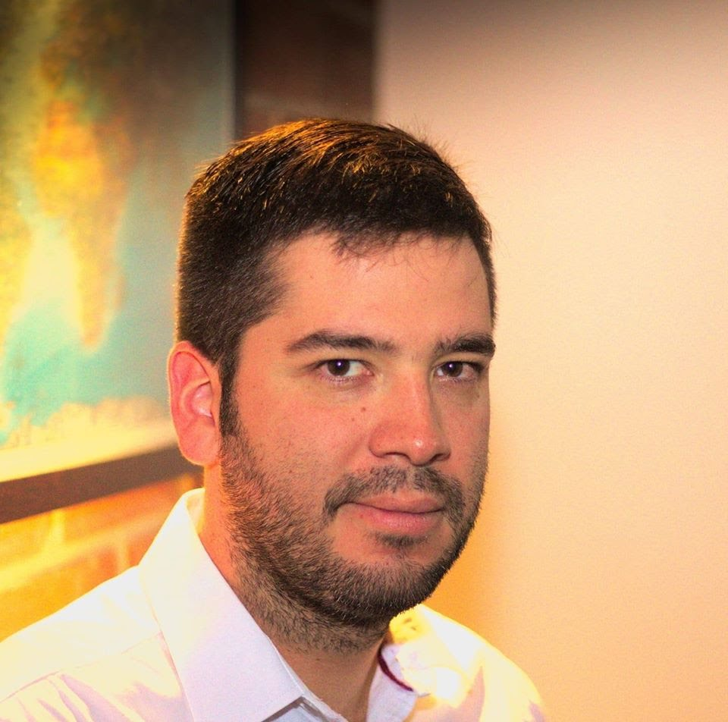
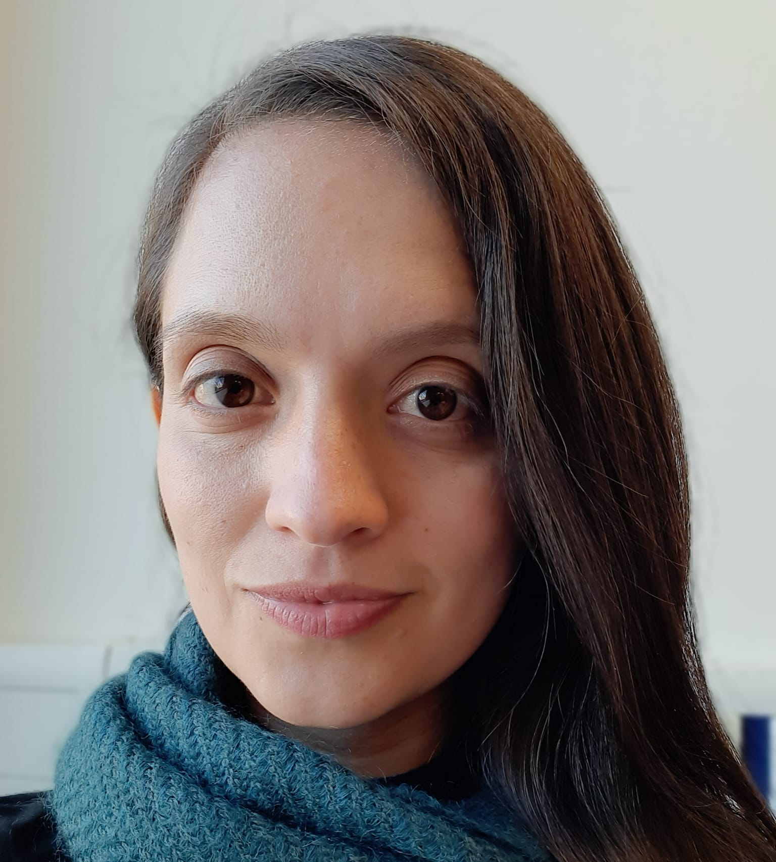

Team presentation
Isabela Osorio
Karol Cuello
Andrea Serna
Literature review
Mauricio Toro
Data Preparation
https://github.com/kvcuellor/Proyecto-Datos-y-Algoritmos.git

Slide 3
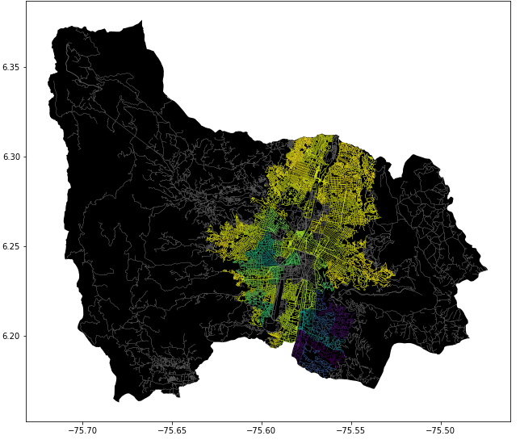
Problem Statement
Algorithm for the shortest path
Medellin Streets, Origin and Destination
Three paths that reduce both the risk of harassment and the distance

Slide 4
Solution algorithm
Dijkstra's algorithm
Medellin Streets, Origin and Destination
A path that reduces both distance and harassment

Slide 5
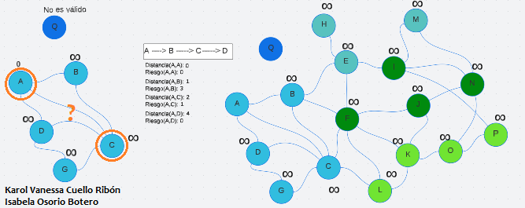
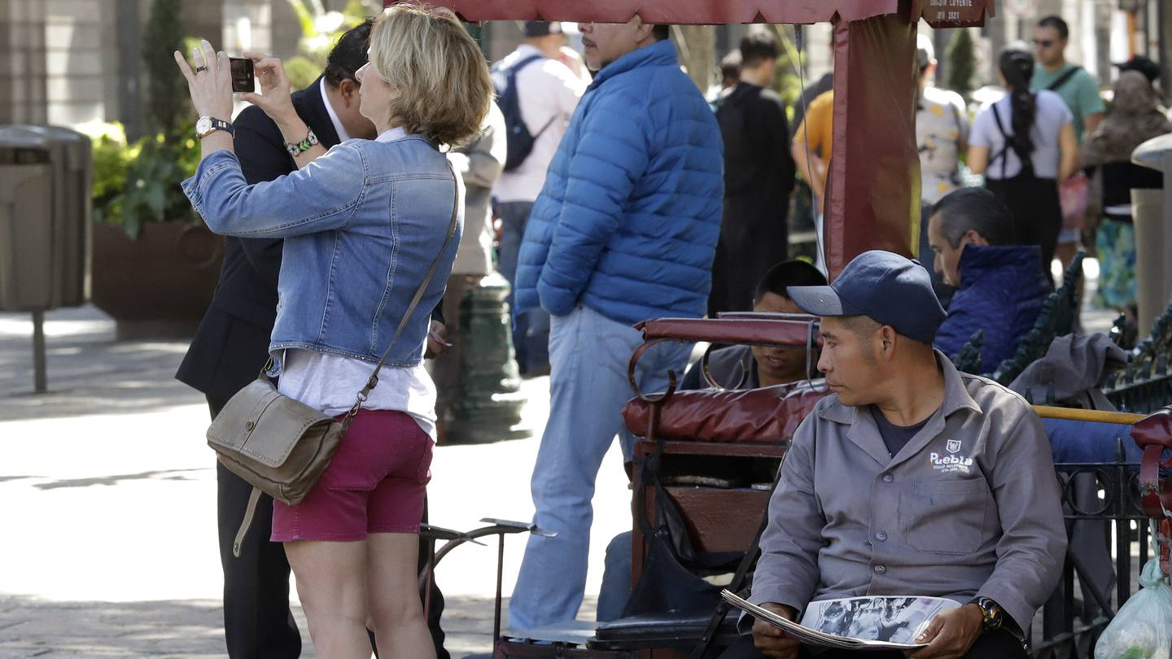
Algorithm explanation
Dijkstra's algorithm, to find the path that reduces both harassment and distance.
It starts by giving the “weights” a value of infinity and then begins to evaluate at each node looking for the lowest value to reach the destination, going through the graph moving through each of the nodes (which are taken with respect to the street address).

Slide 6

Complexity of the algorithm
 | Temporal complexity | Memory complexity
Dijkstra | O(V²) | O(V)
Time and memory complexity of Dijkstra's algorithm. V represents the number of vertices or nodes.

Slide 7
First path that minimizes x = d+r
Source | Destiny | Distance (meters) | Harassment risk (between 0 and 1)
Universidad EAFIT | Universidad de Antioquia | 11305.436 | 0.7289
Distance and risk of harassment for the road that minimizes x = distance+risk. Execution time of 68 seconds.

Slide 8
Second path that minimizes x = d*r
Source | Destiny | Distance (meters) | Harassment risk (between 0 and 1)
Universidad EAFIT | Universidad de Antioquia | 16846.849 | 0.4864
Distance and risk of harassment for the road that minimizes x = distance*risk. Execution time of 71 seconds.

Slide 9
Third path that minimizes x = d+(r*1000)
Source | Destiny | Distance (meters) | Harassment risk (between 0 and 1)
Universidad EAFIT | Universidad de Antioquia | 14210.585 | 0.5461
Distance and risk of harassment for the road that minimizes x = distance+(risk*1000). Execution time of 77 seconds.

Slide 10
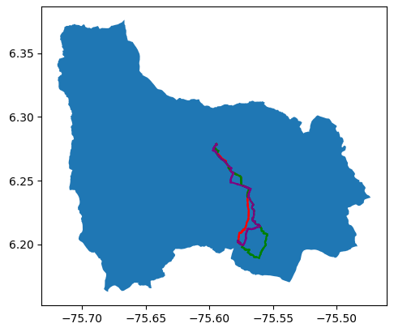
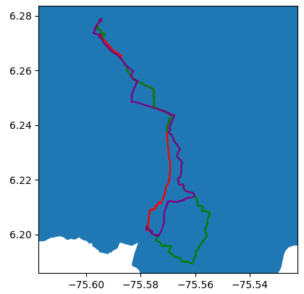
Visual comparison of the three paths

Slide 11

Future work directions
Proyecto 2
Proyecto 2
Probability Theory
Proyecto 1
Optimization 1
Web Apps: Since it loads on the web server and runs in the browser They are quite useful, works for all phones, no updates needed, they do not take up space unlike mobile apps, and they are also cheaper to develop.
VR= the two environments communicate and exchange information . The interface is a translator between the user and the virtual reality . If the user applies , the interface translates these actions.
Bi objective optimization: Guarantees assertive decision making, thanks to human input (qualitative vision/knowledge).
Harvest
Organization and analysis
Tracing
Other risk estimates: such as weather, vehicle traffic, time of day, etc. It helps us to make a more precise distribution of probability, to decide which risk prevails over the others.

Slide 12
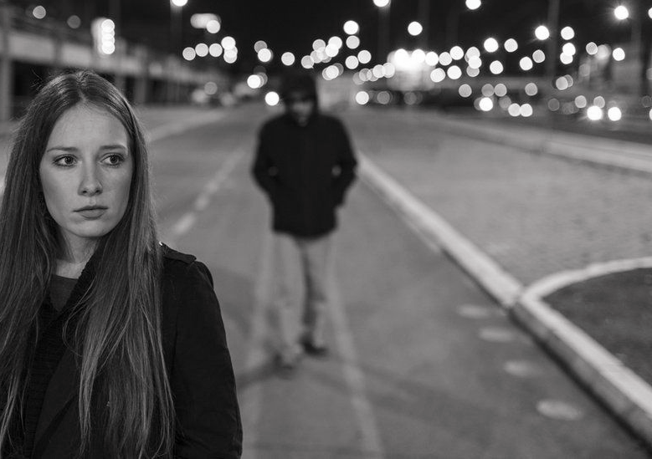
¡THANKS!!
With the support of
The last two authors were supported by the Sapiencia scholarship, financed by the municipality of Medellín. The first two for the employee scholarship and the Andi scholarship, respectively, financed by the EAFIT University. All the authors thank the Vice-rector for Discovery and Creation, of the EAFIT University, for their support in this research.

